Slide 1
Chap 6
Big Data and Hadoop

Slide 2
What is Data?
The quantities, characters, or symbols on which operations are performed by a computer, which may be stored and transmitted in the form of electrical signals and recorded on magnetic, optical, or mechanical recording media.
What is Big Data?
Big Data is a collection of data that is huge in volume, yet growing exponentially with time. It is a data with so large size and complexity that none of traditional data management tools can store it or process it efficiently. Big data is also a data but with huge size.

Slide 3
Types Of Big Data
Structured
Any data that can be stored, accessed and processed in the form of fixed format is termed as a 'structured' data
Unstructured
Any data with unknown form or the structure is classified as unstructured data. In addition to the size being huge, un-structured data poses multiple challenges in terms of its processing for deriving value out of it. A typical example of unstructured data is a heterogeneous data source containing a combination of simple text files, images, videos etc.
Semi-structured
Semi-structured data can contain both the forms of data. We can see semi-structured data as a structured in form but it is actually not defined with e.g. a table definition in relational DBMS. Example of semi-structured data is a data represented in an XML file.

Slide 4
Characteristics Of Big Data
Big data can be described by the following characteristics:
Volume
Variety
Velocity
Variability

Slide 5
(i) Volume – The name Big Data itself is related to a size which is enormous. Size of data plays a very crucial role in determining value out of data. Also, whether a particular data can actually be considered as a Big Data or not, is dependent upon the volume of data. Hence, 'Volume' is one characteristic which needs to be considered while dealing with Big Data.
(ii) Variety – The next aspect of Big Data is its variety.
Variety refers to heterogeneous sources and the nature of data, both structured and unstructured. During earlier days, spreadsheets and databases were the only sources of data considered by most of the applications. Nowadays, data in the form of emails, photos, videos, monitoring devices, PDFs, audio, etc. are also being considered in the analysis applications. This variety of unstructured data poses certain issues for storage, mining and analyzing data.
(iii) Velocity – The term 'velocity' refers to the speed of generation of data. How fast the data is generated and processed to meet the demands, determines real potential in the data.
Big Data Velocity deals with the speed at which data flows in from sources like business processes, application logs, networks, and social media sites, sensors, Mobile devices, etc. The flow of data is massive and continuous.
(iv) Variability – This refers to the inconsistency which can be shown by the data at times, thus hampering the process of being able to handle and manage the data effectively.

Slide 6
What is Hadoop?
Hadoop is an open source software programming framework for storing a large amount of data and performing the computation. Its framework is based on Java programming with some native code in C and shell scripts.
Hadoop Architecture
At its core, Hadoop has two major layers namely −
Processing/Computation layer (MapReduce), and
Storage layer (Hadoop Distributed File System).

Slide 7
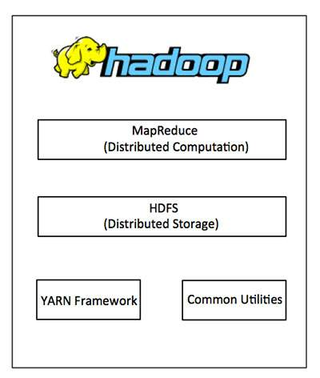
Hadoop Architecure
MapReduce
MapReduce is a parallel programming model for writing distributed applications devised at Google for efficient processing of large amounts of data (multi-terabyte data-sets), on large clusters (thousands of nodes) of commodity hardware in a reliable, fault-tolerant manner.
The MapReduce program runs on Hadoop which is an Apache open-source framework.

Slide 8
Hadoop Distributed File System
The Hadoop Distributed File System (HDFS) is based on the Google File System (GFS) and provides a distributed file system that is designed to run on commodity hardware. It has many similarities with existing distributed file systems. However, the differences from other distributed file systems are significant. It is highly fault-tolerant and is designed to be deployed on low-cost hardware. It provides high throughput access to application data and is suitable for applications having large datasets.
Apart from the above-mentioned two core components, Hadoop framework also includes the following two modules −
Hadoop Common − These are Java libraries and utilities required by other Hadoop modules.
Hadoop YARN − This is a framework for job scheduling and cluster resource management.

Slide 9
How Does Hadoop Work?
It is quite expensive to build bigger servers with heavy configurations that handle large scale processing, but as an alternative, you can tie together many commodity computers with single-CPU, as a single functional distributed system and practically, the clustered machines can read the dataset in parallel and provide a much higher throughput. Moreover, it is cheaper than one high-end server. So this is the first motivational factor behind using Hadoop that it runs across clustered and low-cost machines.
Hadoop runs code across a cluster of computers. This process includes the following core tasks that Hadoop performs −
Data is initially divided into directories and files. Files are divided into uniform sized blocks of 128M and 64M (preferably 128M).
These files are then distributed across various cluster nodes for further processing.
HDFS, being on top of the local file system, supervises the processing.
Blocks are replicated for handling hardware failure.
Checking that the code was executed successfully.
Performing the sort that takes place between the map and reduce stages.
Sending the sorted data to a certain computer.
Writing the debugging logs for each job.

Slide 10
Advantages of Hadoop
Hadoop framework allows the user to quickly write and test distributed systems. It is efficient, and it automatic distributes the data and work across the machines and in turn, utilizes the underlying parallelism of the CPU cores.
Hadoop does not rely on hardware to provide fault-tolerance and high availability (FTHA), rather Hadoop library itself has been designed to detect and handle failures at the application layer.
Servers can be added or removed from the cluster dynamically and Hadoop continues to operate without interruption.
Another big advantage of Hadoop is that apart from being open source, it is compatible on all the platforms since it is Java based.

Slide 11
HDFC
HDFS holds very large amount of data and provides easier access. To store such huge data, the files are stored across multiple machines. These files are stored in redundant fashion to rescue the system from possible data losses in case of failure. HDFS also makes applications available to parallel processing
Features of HDFS
It is suitable for the distributed storage and processing.
Hadoop provides a command interface to interact with HDFS.
The built-in servers of namenode and datanode help users to easily check the status of cluster.
Streaming access to file system data.
HDFS provides file permissions and authentication.

Slide 12
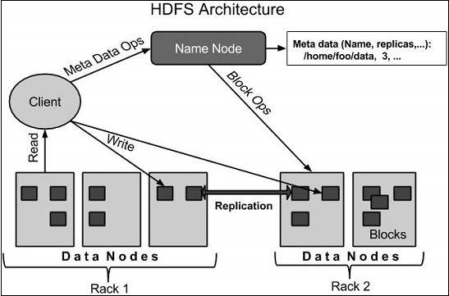
HDFS Architecture

Slide 13
Namenode
The namenode is the commodity hardware that contains the GNU/Linux operating system and the namenode software. It is a software that can be run on commodity hardware. The system having the namenode acts as the master server and it does the following tasks −
Manages the file system namespace.
Regulates client’s access to files.
It also executes file system operations such as renaming, closing, and opening files and directories.
Datanode
The datanode is a commodity hardware having the GNU/Linux operating system and datanode software. For every node (Commodity hardware/System) in a cluster, there will be a datanode. These nodes manage the data storage of their system.
Datanodes perform read-write operations on the file systems, as per client request.
They also perform operations such as block creation, deletion, and replication according to the instructions of the namenode.
Block
Generally the user data is stored in the files of HDFS. The file in a file system will be divided into one or more segments and/or stored in individual data nodes. These file segments are called as blocks. In other words, the minimum amount of data that HDFS can read or write is called a Block. The default block size is 64MB, but it can be increased as per the need to change in HDFS configuration.

Slide 14
Goals of HDFS
Fault detection and recovery − Since HDFS includes a large number of commodity hardware, failure of components is frequent. Therefore HDFS should have mechanisms for quick and automatic fault detection and recovery.
Huge datasets − HDFS should have hundreds of nodes per cluster to manage the applications having huge datasets.
Hardware at data − A requested task can be done efficiently, when the computation takes place near the data. Especially where huge datasets are involved, it reduces the network traffic and increases the throughput.

Slide 15
Hadoop command
https://data-flair.training/blogs/top-hadoop-hdfs-commands-tutorial/

